Slide 1
Introduction To Software Engineering
CHAPTER 2

Slide 2
A Layered Technology
tools
methods
process model
a “quality” focus
Software Engineering

Slide 3
Software engineering is a layered technology. The foundation for software engineering is the process layer. The software engineering process is the glue that holds the technology layers together and enables rational and timely development of computer software. Process defines a framework that must be established for effective delivery of software engineering technology. The software process forms the basis for management control of software projects and establishes the context in which technical methods are applied, work products (models, documents, data, reports, forms, etc.) are produced, milestones are established, quality is ensured, and change is properly managed.
Software engineering methods provide the technical how-to’s for building software. Methods encompass a broad array of tasks that include communication, requirements analysis, design modeling, program construction, testing, and support. Software engineering methods rely on a set of basic principles that govern each area of the technology and include modeling activities and other descriptive techniques.

Slide 4
Software engineering tools provide automated or semi automated support for the process and the methods. When tools are integrated so that information created by one tool can be used by another, a system for the support of software development, called computer-aided software engineering, is established.

Slide 5
The Software Process
A process is a collection of activities, actions, and tasks that are performed when some work product is to be created.
An activity strives to achieve a broad objective (e.g., communication with stakeholders) and is applied regardless of the application domain, size of the project, complexity of the effort, or degree of rigor with which software engineering is to be applied.
An action (e.g., architectural design) encompasses a set of tasks that produce a major work product (e.g., an architectural design model).
A task focuses on a small, but well-defined objective (e.g., conducting a unit test) that produces a tangible outcome

Slide 6
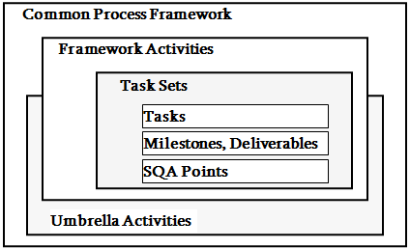
A Process Framework
Process framework
Framework activities
work tasks
work products
milestones & deliverables
QA checkpoints
Umbrella Activities

Slide 7
A Process Framework
A process framework establishes the foundation for a complete software engineering process by identifying a small number of framework activities that are applicable to all software projects, regardless of their size or complexity.
In addition, the process framework encompasses a set of umbrella activities that are applicable across the entire software process. A generic process framework for software engineering encompasses five activities:

Slide 8
Framework Activities
Communication
Planning
Modeling
Analysis of requirements
Design
Construction
Code generation
Testing
Deployment

Slide 9
Framework Activities
Communication
–involves heavy communication with the customer(and other stakeholders) and encompasses requirements gathering.
•Planning
–Describes the technical tasks to be conducted, the risks that are likely, resources that will be required, the work products to be produced and a work schedule

Slide 10
Framework Activities
Modeling
–encompasses the creation of models that allow the developer and customer to better understand S/W req.
•Construction
–combines code generation and the testing required uncovering errors in the code
•Deployment
–deliver the product to the customer who evaluates the delivered product and provides feedback

Slide 11
Umbrella Activities
Software engineering process framework activities are complemented by a number of umbrella activities. In general, umbrella activities are applied throughout a software project and help a software team manage and control progress, quality, change, and risk. Typical umbrella activities include:

Slide 12
Umbrella Activities
Software project tracking and control—allows the software team to assess progress against the project plan and take any necessary action to maintain the schedule.
Risk management— assesses risks that may affect the outcome of the project or the quality of the product.
Software quality assurance —defines and conducts the activities required to ensure software quality

Slide 13
Umbrella Activities
Technical reviews— assesses software engineering work products in an effort to uncover and remove errors before they are propagated to the next activity.
Measurement —defines and collects process, project, and product measures that assist the team in delivering software that meets stakeholders’ needs; can be used in conjunction with all other framework and umbrella activities.
Software configuration management —manages the effects of change throughout the software process.

Slide 14
Umbrella Activities
Reusability management —defines criteria for work product reuse (including software components) and establishes mechanisms to achieve reusable components.
Work product preparation and production —encompasses the activities required to create work products such as models, documents, logs, forms, and lists.

Slide 15
Adapting a Process Model
a process adopted for one project might be significantly different than a process adopted for another project. Among the differences are:

Slide 16
Adapting a Process Model
the overall flow of activities, actions, and tasks and the interdependencies among them
the degree to which actions and tasks are defined within each framework activity
the degree to which work products are identified and required
the manner which quality assurance activities are applied
the manner in which project tracking and control activities are applied
the overall degree of detail and rigor with which the process is described
the degree to which the customer and other stakeholders are involved with the project
the level of autonomy given to the software team
the degree to which team organization and roles are prescribed

Slide 17
A Generic Process Model
a process was defined as a collection of work activities, actions, and tasks that are performed when some work product is to be created. Each of these activities, actions, and tasks reside within a framework or model that defines their relationship with the process and with one another.
The software process is represented schematically in Figure . Referring to the figure, each framework activity is populated by a set of software engineering actions. Each software engineering action is defined by a task set that identifies the work tasks that are to be completed, the work products that will be produced, the quality assurance points that will be required, and the milestones that will be used to indicate progress.

Slide 18
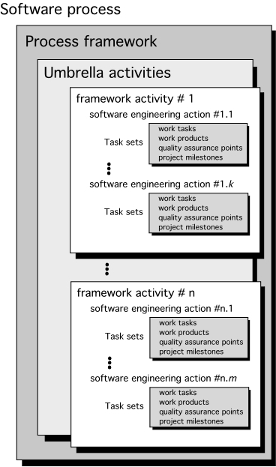
A Generic Process Model

Slide 19
process flow—describes how the framework activities and the actions and tasks that occur within each framework activity are organized with respect to sequence and time and is illustrated in Figure.

Slide 20
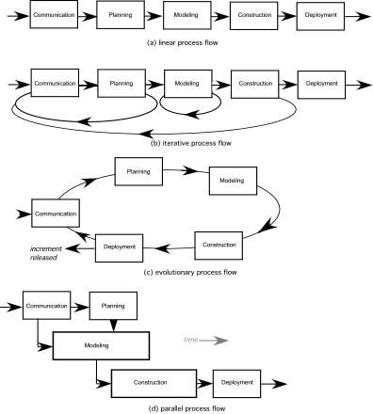

Slide 21
A linear process flow executes each of the five framework activities in sequence, beginning with communication and culminating with deployment (Figure 2.2a).
An iterative process flow repeats one or more of the activities before proceeding to the next (Figure 2.2b).
An evolutionary process flow executes the activities in a “circular” manner. Each circuit through the five activities leads to a more complete version of the software (Figure 2.2c).
A parallel process flow (Figure 2.2d) executes one or more activities in parallel with other activities (e.g., modeling for one aspect of the software might be executed in parallel with construction of another aspect of the software).

Slide 22
Identifying a Task Set
A task set defines the actual work to be done to accomplish the objectives of a software engineering action.
A list of the task to be accomplished
A list of the work products to be produced
A list of the quality assurance filters to be applied

Slide 23
Process Patterns
A process pattern
describes a process-related problem that is encountered during software engineering work,
identifies the environment in which the problem has been encountered, and
suggests one or more proven solutions to the problem.
Stated in more general terms, a process pattern provides you with a template [Ambler]—a consistent method for describing problem solutions within the context of the software process.

Slide 24
Stage patterns—defines a problem associated with a framework activity for the process.
Task patterns—defines a problem associated with a software engineering action or work task and relevant to successful software engineering practice
Phase patterns—define the sequence of framework activities that occur with the process, even when the overall flow of activities is iterative in nature

Slide 25
Plan-driven and agile processes
Plan-driven processes are processes where all of the process activities are planned in advance and progress is measured against this plan.
•In agile processes, planning is incremental and it is easier to change the process to reflect changing customer requirements.
•In practice, most practical processes include elements of both plan-driven and agile approaches.
•There are no right or wrong software processes.

Slide 26
The people involved with software
The following are software "stakeholders", i.e., people who have some interest in a software product and/or its development
–end users--people who will use the software or people who represent those who will use it
–customers--people who purchase the software, which they may or may use themselves

Slide 27
domain experts--people who fully understand the application domain in which the software will run
–analysts--members of the software development staff who specialize in requirements analysis and specification
–implementers--members of the development staff who specialize in software design and implementation
–testers--members of the development staff and user community who test the software to ensure that it meets the requirements specification

Slide 28
managers--those who manage the development process, as well as those who manage end users when the software is installed in an organization
–visionaries--those who have the "big picture" for what the software is intended to do and how it will be developed
–maintainers and operators--those who conduct post-development maintenance and operations, as necessary
–other interested parties--anyone else interested in the software product, such as those with a financial investment

Slide 29
Generic Phases
Definition Phase
Focus on ‘what’the software is
Development Phase
Focus on ‘how’the software works
Maintenance Phase
Focus on ‘change’ to the software

Slide 30
Definition phase
•Identify information to be processed
•Identify system behavior -functions and performance
•Détermine constraints , interfaces, validation criteria
•Major tasks:
System engineering
Software project planning
Requirements analysis

Slide 31
Development phase
•Define data structures, function implementation, procedural details, interfaces
•Translate design to programming language
•How testing is performed
•Major tasks:
Software design
Code generation
Software testing

Slide 32
Maintenance phase
Reapplies definition and development phases to existing software
•Types of changes:
Correction
Adaptation
Enhancement
Prevention

